Slide 1
DOS UNIT-II Communication in Distributed systems
Lecture-1

Slide 2
Layered Protocols
Due to the absence of shared memory all communications in DS is based on message passing.
Some issuses that involved in the communication process are:
How many volts are used to signal a 0-bit, and how many volts for a 1-bit?
How does the receiver knows which is the last bit of the message?
How can the receiver detect if a message has been damaged or lost, and what should it do in this situation?
How long are numbers, strings, and other data items, and how are they represented?
To deal with all such issues, the International Standard Organization (ISO) has developed a reference model that clearly identifies the various levels involved, gives them standard names, and points out which level should do which job.
This model is called as the Open System Interconnection reference model, usually abberiviated as ISO OSI or the OSI model.

Slide 3
Cont..
NOTE: The ISO-OSI model is considered as a reference model because from this model a reference has been taken for the principles of networking.
It is not an accurate representation of how networks actually work, but it is useful for explaining the layers and their functions.
The OSI model was originally used in networks but was replaced by TCP/IP architecture when it became commercially adopted.
The OSI model is designed to allow open systems to communicate.
An open system is one that is prepared to communicate with any other open system by using standard rules that governs the format, contents, and meaning of the messages sent and received.
These rules are formalized in what are called protocols.
A protocol is an agreement between the communicating parties on how the communication is to proceed.

Slide 4
Cont..
The OSI model distinguishes between two general types of protocols:
In a connection-oriented protocol, a logical connection to be established between the two processes before data is exchanged. The connection must be maintained during the entire time that communication is taking place, then released afterwards.
The telephone is an example of connection-oriented communication.
With a connectionless protocol, no setup in advance is needed. The sender just transmits the first message when it is ready
Dropping a letter in mailbox is an example of connection less protocol.
In the OSI model, the communication is divided up in the seven levels or layers, as shown in the next slide.
Each layer deals with one specific aspect of communication.
Each layer provides an interface to the one above it.
The interface consists of a set of operations that together define the service the layer is prepared to offer to the users.

Slide 5
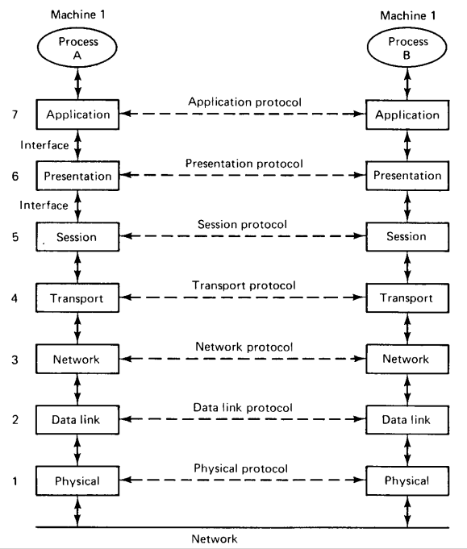
Cont..

Slide 6
Cont..
In the OSI model when process A on machine 1 wants to communicate with process B on machine 2, it builds a message and passes the message to the application layer on its machine.
This layer might be a library procedure, for example, but it could also be implemented in some other way (e.g., inside the operating system, on an external coprocessor chip, etc).
The application layers software then adds a header to the front of the message and passes the resulting message across the layer 6/7 interface to the presentation layer.
The presentation layer in turn adds its own header and passes the result down to the session layer, and so on.
Some layers add not only a header to the front, but also a trailer to the end.
When the message arrives at machine 2, it is passed upward, with each layer stripping off and examining its own header.
Finally the message arrives at the receiver, process B, which may reply to it using the riverse path.

Slide 7
Cont..
The Physical Layer:
The physical layer is concerned with transmitting the 0s and 1s.
How many volts to use for 0 and 1, how many bits per second can be sent, and whether transmission can take place in both directions simultaneously are key issues in the physical layer.
In addition, the size and shape of the network connector as well as the number of pins and meaning of each are of concern.
The physical layer protocol deals with standardizing the electrical, mechanical, and signalling interfaces so that when one machine sends a 0 bit it is actually received as the 0 bit and not a 1 bit.

Slide 8
Cont..
Data Link Layer (DLL):
The physical layer just sends bits. As long as no errors occur all is well.
However, real communication networks are subject to errors so some mechanism is needed to detect and correct them.
This mechanism is the main task of the data link layer.
What it does is to group the bits into units called frames, and see that each frame is correctly received.
The data link layer does its work by putting a special bit pattern on the start and end of each frame, to mark them, as well as computing a checksum by adding up all the bytes in the frame in a certain way.
The data link layer appends the checksum to the frame.
When the frame arrives, the receiver recomputes the checksum from the data and compares the result to the checksum following the frame.
If they agree, the frame is considered correct and is accepted. If they disagree, the receiver asks the sender to retransmit it.
Frames are assigned sequence numbers (in the header) for getting the correct sequence.

Slide 9
Cont..
The Network Layer:
In a WAN, for a message to get from the sender to the receiver, it may have to cross a number of hops.
The question of how to choose the best path is called routing, and is the primary task of the NL.
The problem is complicated by the fact that the shortest route is not always the best route.
What really matters is the amount of delay on a given route, which, in turn, is related to the amount of traffic and the number of messages queued up for transmission.
The delay can thus change over the course of time.
Two NL protocols are in widespread use, one connection-oriented called X.25 and another connectionless called Internet Protocol (IP).

Slide 10
Cont..
The Transport Layer:
The transport layer is positioned between the network and session layers in the OSI paradigm.
The data packets must be taken and sent to the appropriate machine by the network layer.
After that, the transport layer receives the packets, sorts them, and looks for faults.
Subsequently, it directs them to the session layer of the appropriate computer program.
Functions of Transport Layer:
The Transport Layer is responsible for end-to-end communication of data packets.
It provides a number of important functions that are responsible for reliable, efficient, and organized data transfer between host systems in a networked environment.
The primary functions of the Transport Layer are:
To enable efficient network transmission, the TL splits the total amount of data it gets from the applications running at the top layers into smaller units known as segments.

Slide 11
Cont..
In situations when organised data transfer is required, the Transport Layer creates a connection between the source and the destination.
When the data transfer is complete, the Transport Layer closes the connection.
The TL also assures dependable data transmission. Receiving acknowledgments, or ACK bits, is how this is accomplished.
Any damaged segments are retransmitted by the sender if they receive an acknowledgment.
Flow control is one of the Transport Layer’s most crucial roles. In order to prevent data overload, it regulates the data transfer rate.
Both error detection and correction are handled by the transport layer using techniques like checksum, CRC, etc.
Transmission Control Protocol (TCP) is a connection-oriented protocol and User Datagram Protocol (UDP) is a connectionless protocol of the TL

Slide 12
Cont..
The Session Layer:
This layer allows users on different machines to establish active communications sessions between them.
It is responsible for establishing, maintaining, synchronizing, terminating sessions between end-user applications.
The Presentation Layer:
This layer is also known as Translation layer, as this layer serves as a data translator for the network.
The data which this layer receives from the Application Layer is extracted and manipulated here as per the required format to transmit over the network.
The main responsibility of this layer is to provide or define the data format and encryption.
The presentation layer is also called as Syntax layer since it is responsible for maintaining the proper syntax of the data which it either receives or transmits to other layer(s).
The Application Layer:
It is called as the user-interface layer.
It is a collection of miscellaneous protocols for common activities such as E-mail, file, transfer, and connecting remote terminals over a network.

